Slide 1




$Λ∘λ$: Functional Lattice Cryptography (Experience Report)
Eric Crockett
Chris Peikert
Georgia Institute of Technology University of Michigan
University of Michigan
crockeea
Notes:
Lambda
Cap and low lamb reflect combo
We refer

Slide 2


$\backslash Lambda∘\backslash lambda$: Functional Lattice Cryptography (Experience Report)
Eric Crockett
Chris Peikert
Georgia Institute of Technology University of Michigan
University of Michigan
crockeea
Notes:
Lambda
Cap and low lamb reflect combo
We refer

Slide 3

$\backslash Lambda∘\backslash lambda$: Functional Lattice Cryptography (Experience Report)
Eric Crockett
Chris Peikert
Georgia Institute of Technology University of Michigan
University of Michigan
crockeea
Notes:
Lambda
Cap and low lamb reflect combo
We refer

Slide 4
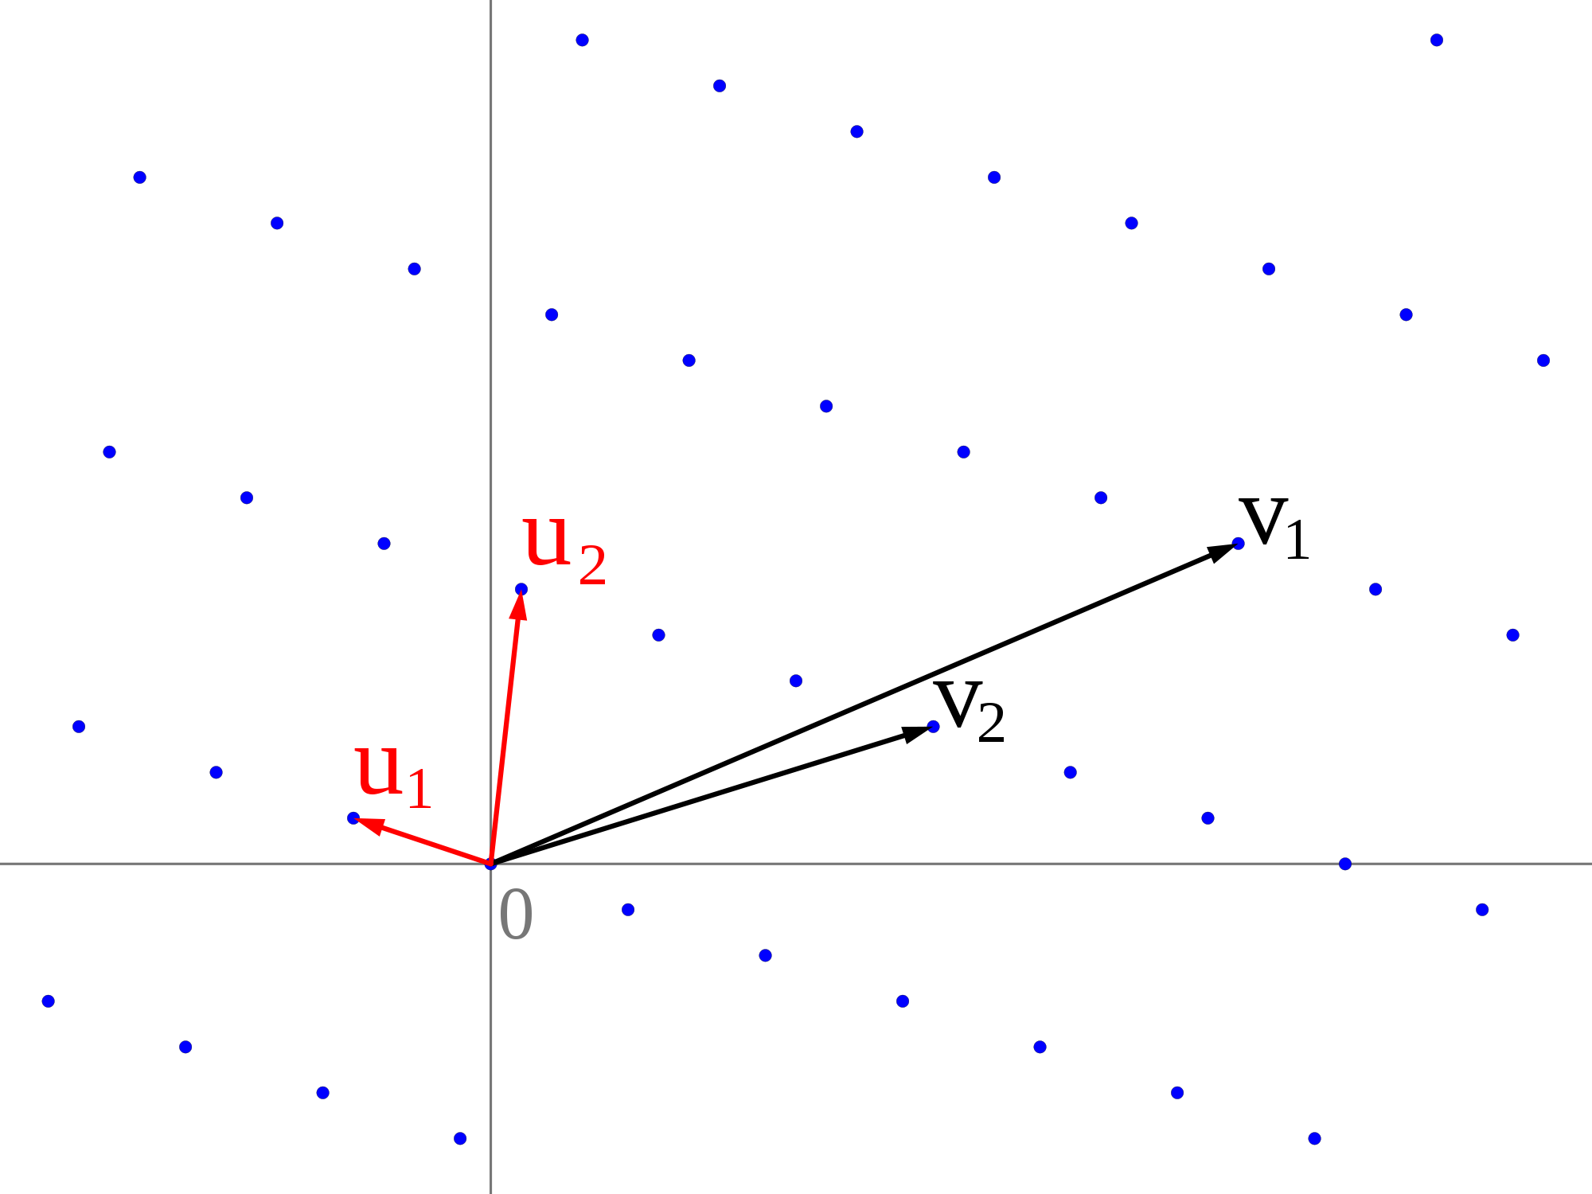
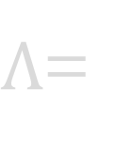
Lattice Cryptography101
Schemes are efficient and embarrassingly parallel
Apparent security against quantum attacks
Security from worst-case hardness assumptions
$Λ$=
Notes:
Lattice schemes and the efficient version based on cyclotomic rings *can* derive security from hard problems on lattices.
Lattice: periodic, infinite hundreds of dims
3 advents
random instances of the problems that schemes are based on are as hard as any instance
Kirin
Don’t mention rings
ABE for arbitrary access functions
Discuss FULLY HE in a little detail

Slide 5





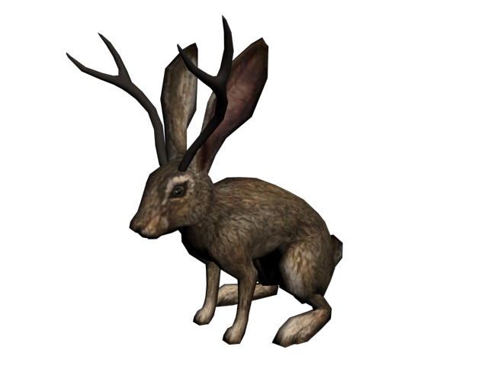
Lattice Cryptography: An Analogy
Schemes are efficient and embarrassingly parallel
Apparent security against quantum attacks
Security from worst-case hardness assumptions
Attribute-based encryption
Pseudorandom function
Crypto Zoo
Fully homomorphic encryption
Actively secure encryption
Collision-resistant hash
Notes:
In this talk/cryptozoology
Cryptids <-> schemes
Some: any zoo
Others: FHE, only realized
Kirin
Don’t mention rings
ABE for arbitrary access functions
Discuss FULLY HE in a little detail

Slide 6
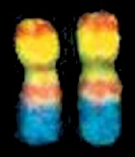
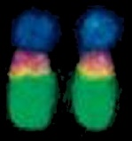
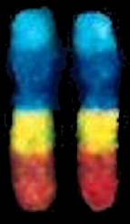
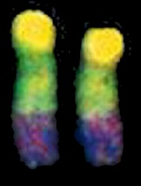




Lattice Cryptography Genes
Gaussian sampling
Matrix arithmetic
Cyclotomic rings
“Gadget” operations
$Λ∘λ$is a general-purpose
library for lattice cryptography
PRF
CRHF
FHE
Notes:
Cryptids may seem mysterious
Handful of genes
List
Lol/genetical eng. Cryptids/combine genes

Slide 7

Introducing $Λ∘λ$
Modular:
Composable interfaces for lattice crypto operations
Builds on Haskell’s algebraic and category-theoretic hierarchies
Theory friendly:
Specialized representations and fast algorithms for cyclotomic rings
Comports with worst-case hardness theorems
Safe: (ab)use type system to statically enforce mathematical constraints
Featureful: support standard & novel operations for rich cryptosystems
Notes:
Designed Lol w/ 4 props:
B1 and B2
Num-pred lib for num classes/algebraic
Spec. reps for cyc rings, fast algs for efficient schemes
Supports th-rec’d algs that ensure w.c.h guars
Designed for correct impls
Use H’s TS and 28 exts to stat enforce invars and m consts
Pushes H’s TS to its limits, and beyond in case of 34 GHC
Includes func not in other impls; permits novel apps
(34 bugs, 8 feature requests, 28 extensions)
bugs:
8406, 8668, 8774, 9386, 9633, 9729, 9733, 9888, 10056, 10195, 10338, 10390, 10427, 10428, 10905, 10924, 10987, 10995, 11248, 11249, 11250, 11498, 11577, 11628, 11948, 12067, 12068, 12074, 12152, 12175, 12395, 12396, 12461, 12574, 12575
Feature reqs:
(8099), 9778, 9784, 9939, 11008, 11243 (12271), 12543

Slide 8






Layers of $Λ∘λ$
Crypto
Cyclotomic
Cyclotomic rings
Ring gadgets
Gaussian sampling
Linear transforms
Sparse decomposition DSL
Tensor
Product rings
Type-level factored nats
Integer
Modular arithmetic
Integer gadgets
Notes:
Lol designed w/ several layers for modularity and clean ifacesI
C-systems make up crypto
Seen these are made of genes, which exposed at Cyc layer
Genes formed from DNA at TL, which exposes linear trans on ts
Trans sparse decomps, express with domain spec
DNA at TL formed from indivis comps of lat crypto: list
We’ll take a closer look at Integer and Tensor layers

Slide 9

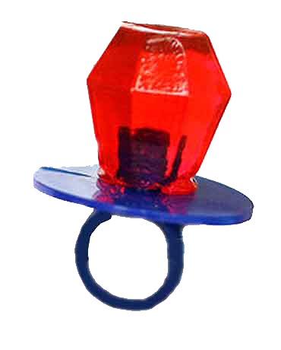
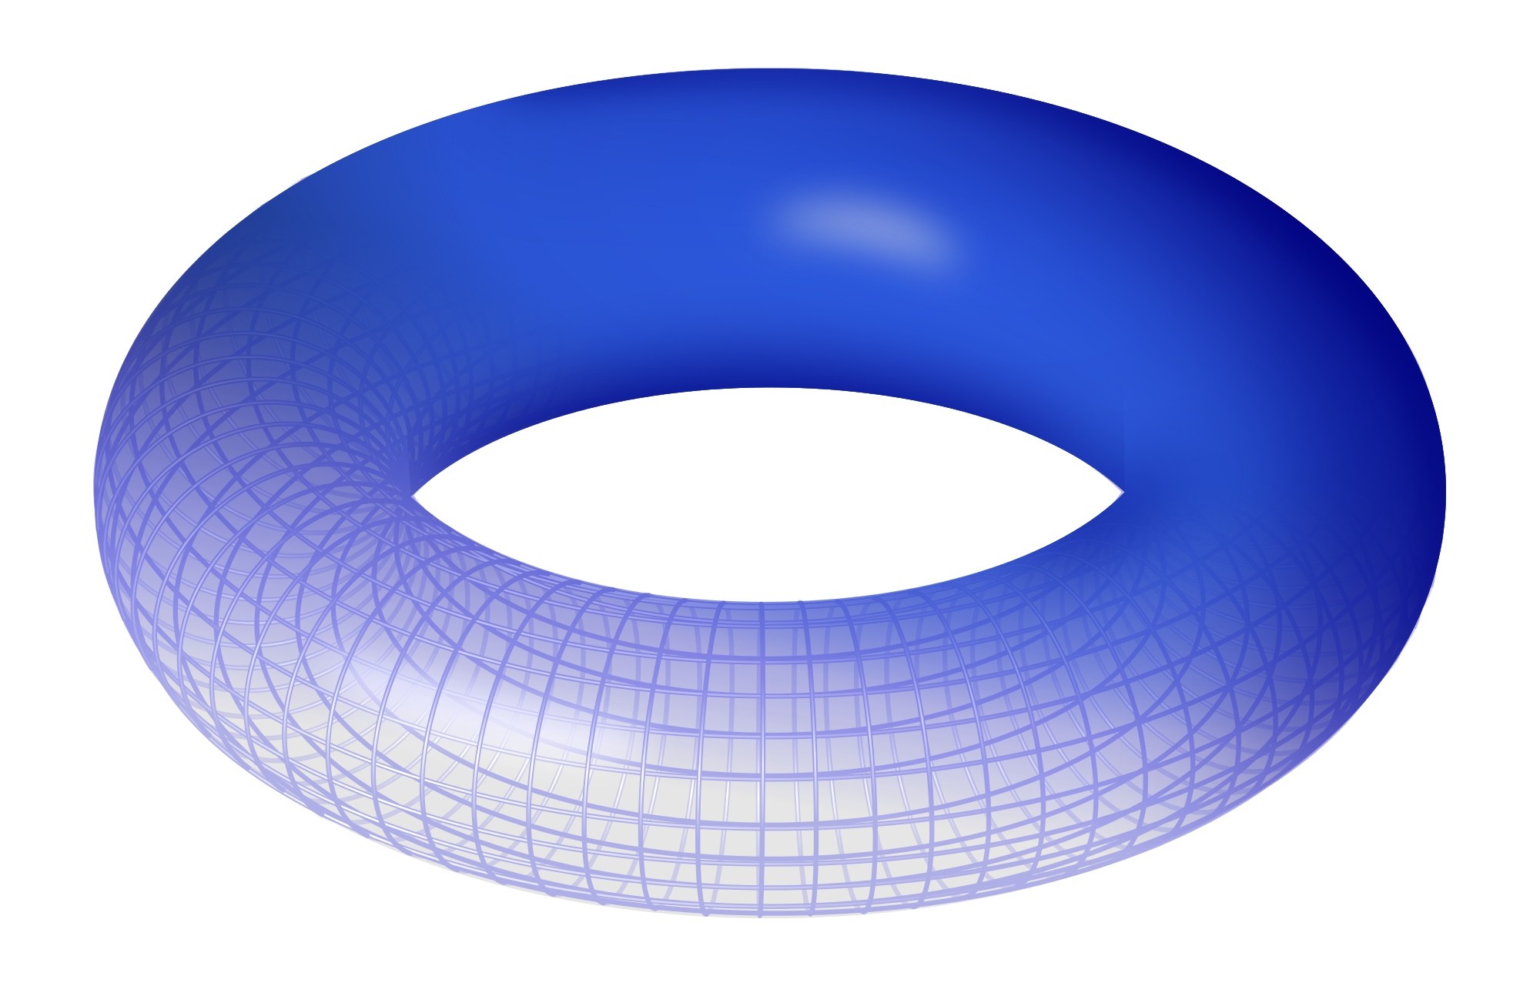
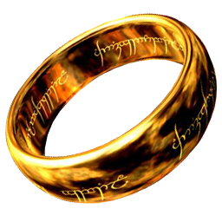





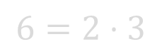

Factored Naturals
ring
$$m$$
$$1$$
$$2$$
$$3$$
$$4=2^{2}$$
$$5$$
$$6=2⋅3$$
Need to expose and manipulate factorization at type level, and translate it between data and type level
We use data kinds [YWC⁺12] and singletons [EW12, ES14] to simulate dependent types
Notes:
Cyc rings def’d by cyc index.
One cyc ring for every pos int m
E.g., m=1 ⬄ “one ring”
Ring ops def’d by fact of m, bc, e.g., R_6 is “prod” of R_2 and R_3
Inter-ring ops have add’l consts, req’ing one idx to div
Like to enforce such consts at TL
Requires exposing fact of idx and maniple at TL
Also move between data/TL reps of idx
Achieve these goals, we use DK & S to sim dep ts

Slide 10
Factored Naturals
singletons [d|
|]
type Divides m m’ = (FDivides m m’ ~ True)
newtype PrimePower = PP (Prime, Pos) newtype Factored = F [PrimePower] fDivides :: Factored -> Factored -> Bool fLCM :: Factored -> Factored -> Factored
DataKinds promotes PrimePower and Factored values to types
Singletons creates type families FDivides and FLCM
Notes:
A PP is a Prime/exp pair
A Factored number is a list of PPs
Given facts, we can easy test divisibility and compute least common mult
DK promotes PP and Fact values to types
Singletonize the defs to get TFs on the promoted types

Slide 11
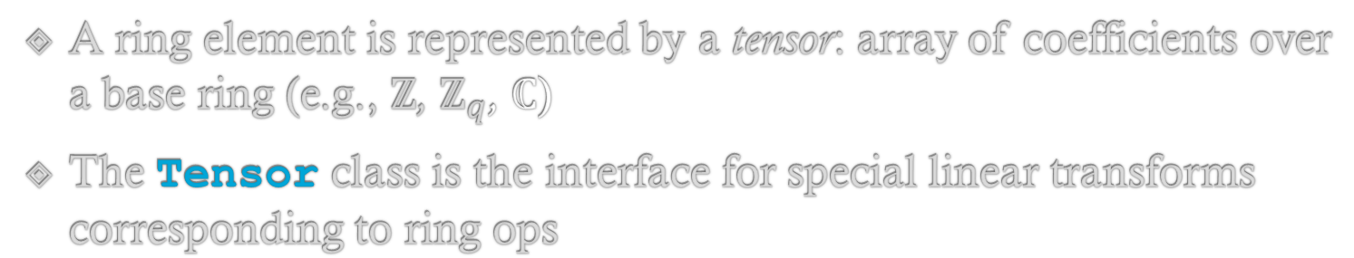
Tensor Layer
A ring element is represented by a tensor: array of coefficients over a base ring (e.g., $ℤ$, $ℤ_{q}$, $ℂ$)
The Tensor class is the interface for special linear transforms corresponding to ring ops
class Tensor (t :: Factored -> * -> *) where
-- allows constrained base ring for efficiency type TElt t r :: Constraint
-- the transforms l,lInv,mulGPow,… :: (Ring r, TElt t r) => t m r -> t m r embedPow, embedDec :: (m `Divides` m', TElt t r) => t m r -> t m’ r
-- simulate superclasses entailCatT :: () :- (Applicative (t m), Foldable (t m)) entailEqT :: (Eq r, TElt t r) :- Eq (t m r)
Notes:
Look at TL
Cyc rings are rep’d by a tensor: arr of coeffs over base ring
Tensor iface has special lin trans on ts corr to ring ops
All trans are impl’d using DSL to gen derive algs from smaller trans based on fact of m
Emph embed m -> m’
Class has single param, unapp’d t type, forces funcs to be impl’d for every m and valid r
Each tensor is param’d by Fact index m and base ring r; Single param allows easy m/r switch
Strong interface prevents us from expressing superclass
Prevents easily expressing supclass consts. (t m) is App, and (t m r) is Eq when r is Eq. Instead, entailment which must be used explicitly
Assoc const fam Telt allows restricted elt type r, e.g., many efficient containers require an Unbox constrain
typic lin trans on ts. Can easy express divisibility
Trevor McDonell

Slide 12
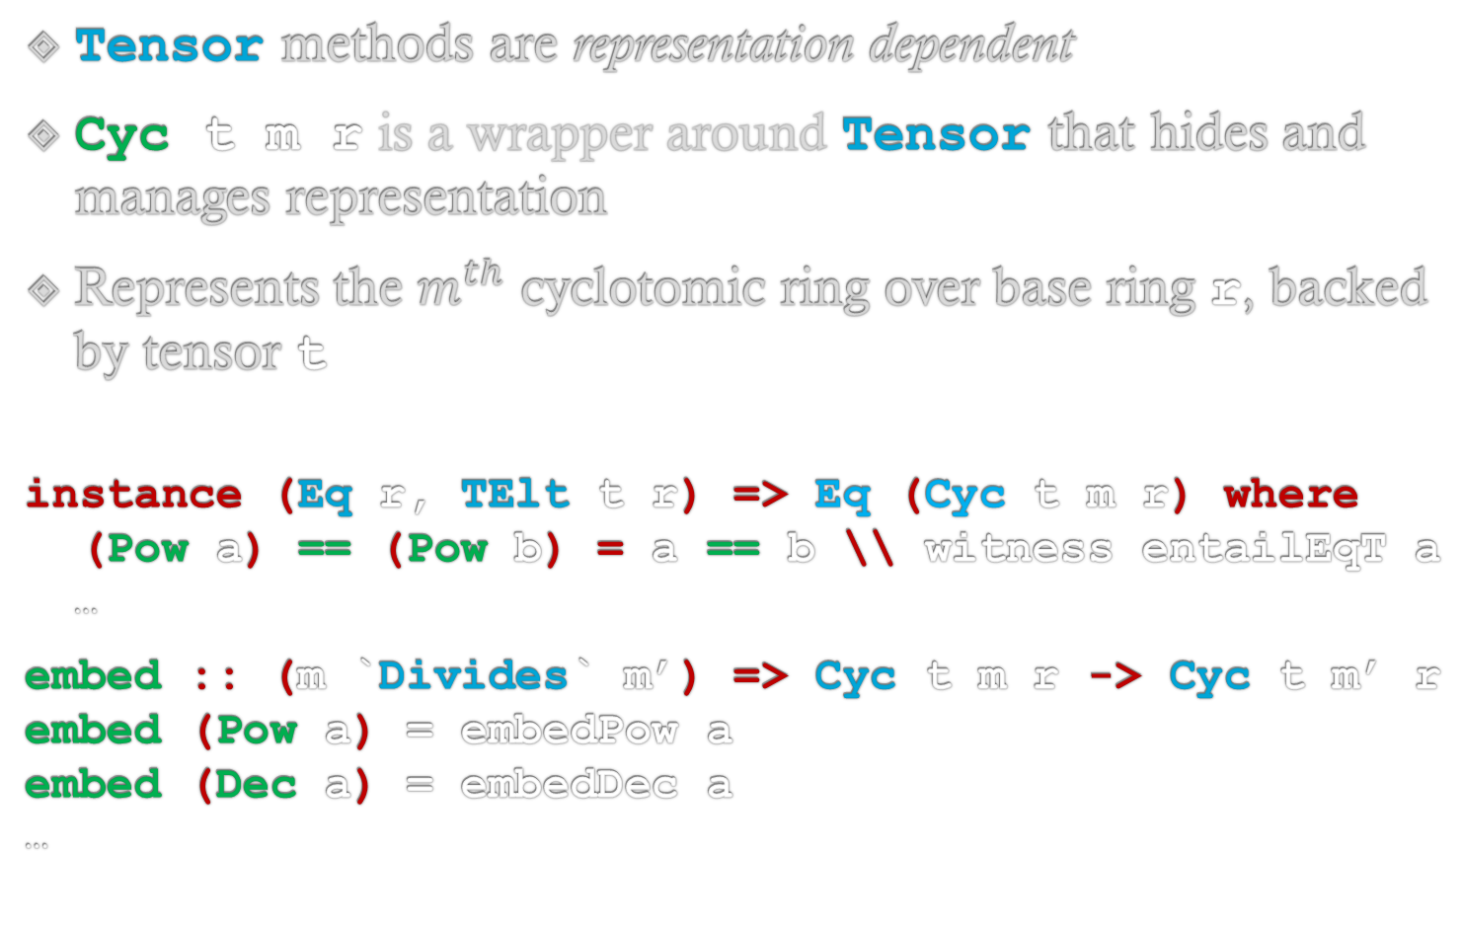
Cyclotomic Rings
Tensor methods are representation dependent
Cyc t m r is a wrapper around Tensor that hides and manages representation
Represents the $m^{th}$ cyclotomic ring over base ring r, backed by tensor t
instance (Eq r, TElt t r) => Eq (Cyc t m r) where (Pow a) == (Pow b) = a == b \\ witness entailEqT a …
embed :: (m `Divides` m’) => Cyc t m r -> Cyc t m’ r embed (Pow a) = embedPow a embed (Dec a) = embedDec a …
Notes:
Cyc is a GADT, t is tensor backend
multiple constructors for different reps (Pow, Dec, CRT, etc). Different reps are necessary/more efficient for some ops
Wrapper tries to choose most efficient rep

Slide 13
Performance
GHC: Compile time is several minutes for top-level modules
Application:
All performance issues are due to (lack of) specialization
INLINE, INLINABLE, and SPECIALIZE don’t reliably induce specialization (#8774)
Constraint synonyms can defeat specialization
We need much more visibility into and control over specialization!
Notes:
Ongoing perf issues; all due to lack of spec
When spec does happen, can be defeated by something as simple as
Application perf seems like black box; main point

Slide 14
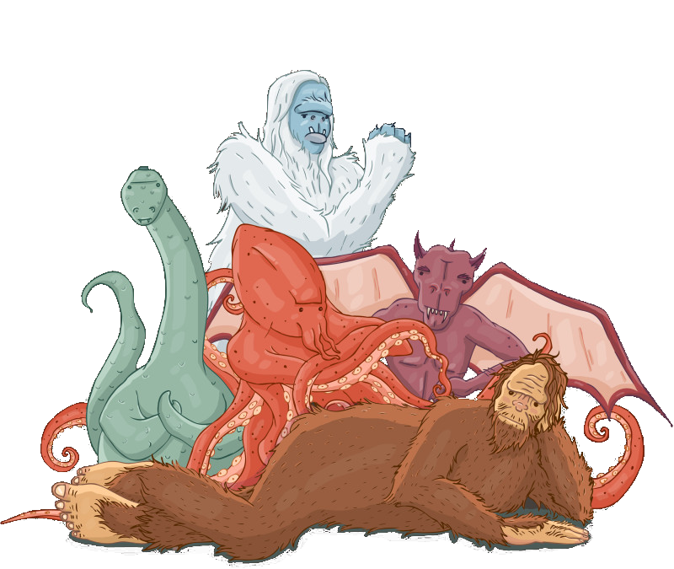




Thank you
Please ask for more details!
To learn more about $Λ∘λ$, visit
https://eprint.iacr.org/2015/1134
https://github.com/cpeikert/lol
https://hackage.haskell.org/package/lol
Notes:
That’s all for now, please find me afterwards for more details!

Slide 15
Images
https://cdn.sstatic.net/Sites/stackoverflow/img/apple-touch-icon@2.png?v=73d79a89bded&a
https://upload.wikimedia.org/wikipedia/commons/thumb/9/91/Octicons-mark-github.svg/2000px-Octicons-mark-github.svg.png
https://trac.edgewall.org/
https://upload.wikimedia.org/wikipedia/commons/thumb/2/27/Lattice-reduction.svg/2000px-Lattice-reduction.svg.png
http://www.twobytwomeandyou.com/5/LL_June_files/zoogate_c.png
http://killingbatteries.com/wp-content/uploads/2013/10/loch_ness_monster.gif
http://vignette2.wikia.nocookie.net/howrse/images/6/63/Qilin-0.png/revision/latest?cb=20141024035649
http://vignette2.wikia.nocookie.net/reddeadredemption/images/c/c3/Lentri.png/revision/latest?cb=20111116113558
https://upload.wikimedia.org/wikipedia/commons/thumb/9/9b/Chupacabras.svg/220px-Chupacabras.svg.png
http://blogs.nwic.edu/pavlik/files/2014/02/Bigfoot.png
http://www.sogab.com.br/user2/FISH_chromosome.jpg
http://www.3dmoleculardesigns.com/3DMD-Files/Demo-DNA-Nucleotides/TeacherNotesNucleotides.jpg?
http://www.icone-png.com/png/51/51458.png
https://octodex.github.com/Kimonotocat
http://www.visual-integrity.com/wp-content/uploads/2016/02/pdf-page.png
https://avatars0.githubusercontent.com/u/450574?v=3&s=400
https://res.cloudinary.com/teepublic/image/private/s--OnRsx4wc--/b_rgb:42332c,c_limit,f_jpg,h_800,q_90,w_800/v1446168514/production/designs/84816_1.jpg
http://www.clipartkid.com/images/63/diamond-ring-clipart-clipart-panda-free-clipart-images-U2VoZf-clipart.gif
http://rocketdock.com/images/screenshots/One-Ring.png
https://upload.wikimedia.org/wikipedia/commons/thumb/4/47/Torus.svg/2000px-Torus.svg.png
http://thefutureofcandy.weebly.com/uploads/3/9/7/7/39773090/s226017162721056366_p3_i2_w370.png

Slide 16
Tests and Benchmarks
Quickcheck/Criterion are designed for monomorphic functions
Our tests and benches are polymorphic over tensors t, indices m, and base rings r
prop_foo :: (Arbitrary (t m r), Tensor t,…) => t m r -> Test badFooTests = testGroup “foo” [ test (prop_foo :: CT F12 (Zq 29) -> Test), prop_foo :: CT F12 (Zq 37) -> Test, prop_foo :: CT F16 (Zq 33) -> Test, … prop_foo :: RT F12 (Zq 29) -> Test, …]
Our workaround is extremely slow to compile and prevents specialization
Need better support for polymorphic tests and benchmarks
Notes:
Switch gear: ongoing practical issues/challenges
Mature H libs work best for mono funcs
Lol extensive use of polymorphism => run poly funcs on different params
Naïve way to monomorphize prop
Lots of dup, even for one property; difficult to change param combos
Workaround: prevents spec and take minutes to recomp, discussion on reddit: impact on productivity
Main point

